Slide 1
Chapter 6

Slide 2
Objectives

Slide 3
Objectives (continued)

Slide 4
The code for a web page

Slide 5
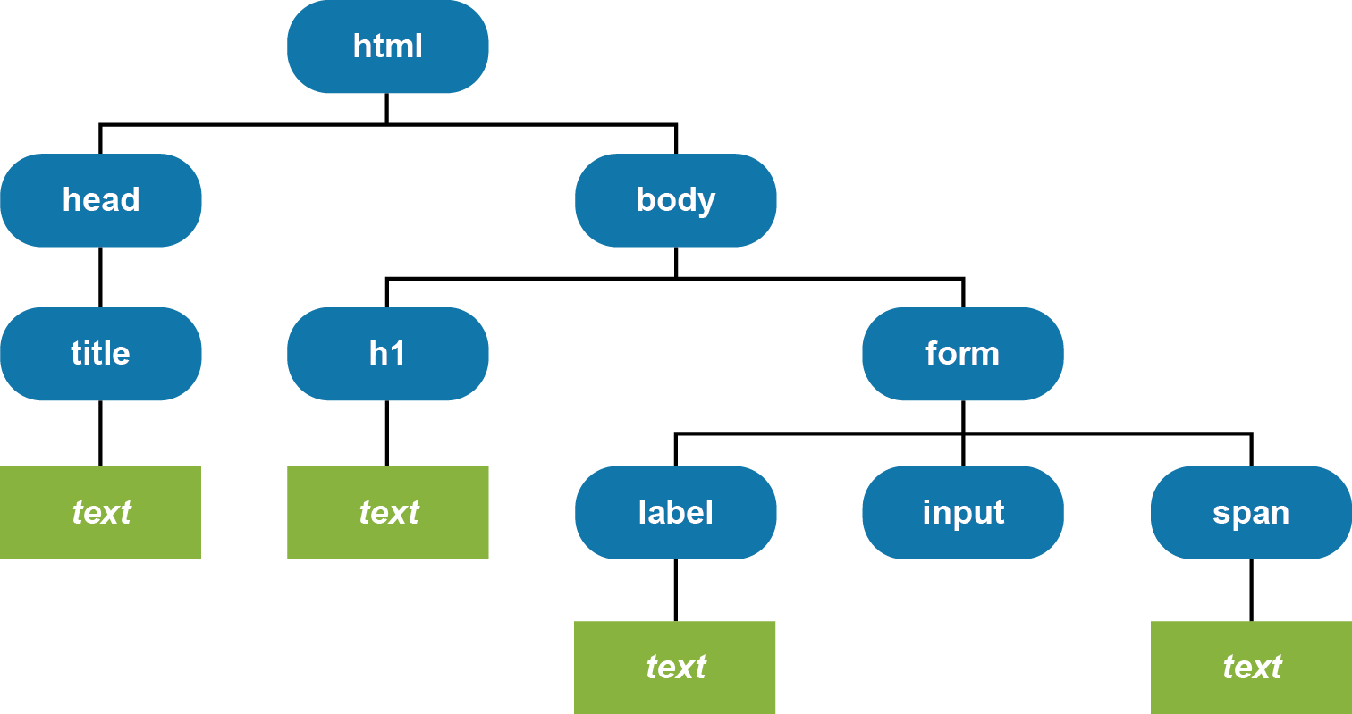
The DOM for the web page

Slide 6
The DOM nodes that you commonly use

Slide 7
Some of the properties of the Node interface

Slide 8
HTML that contains element and text nodes

Slide 9
How to get the text of an HTML element with “email_error” as its id

Slide 10
Common methods of the Document and Element interfaces

Slide 11
How to create an array of all <a> tags in a document

Slide 12
How to test for and get an attribute

Slide 13
The URL for the DOM HTML specification

Slide 14
Typical properties available with the DOM HTML specification

Slide 15
How the DOM HTML specification can simplify your code

Slide 16
Other examples of using the DOM HTML specification

Slide 17
Other examples of using the DOM HTML specification (continued)

Slide 18
Terms

Slide 19
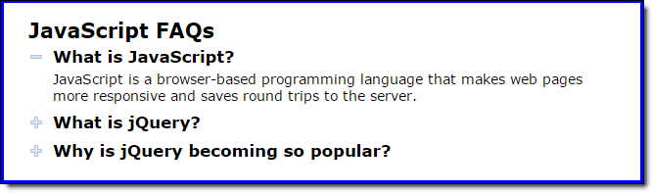
The FAQs application in a browser

Slide 20
The HTML for the FAQs application

Slide 21
The HTML (continued)

Slide 22
The CSS for the FAQs application

Slide 23
The JavaScript for the FAQs application

Slide 24
The JavaScript for the FAQs application (cont.)

Slide 25
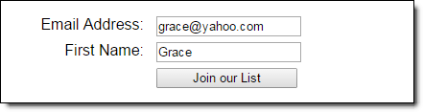
A form in a web browser

Slide 26
The HTML for the form

Slide 27
The URL that’s sent when the form is submitted with the get method

Slide 28
Attributes of the form element

Slide 29
Terms

Slide 30
Property of a Textbox, Textarea, or Select object

Slide 31
HTML code for a text box, text area, and select list

Slide 32
JavaScript code to get the text box, text area, and select list values

Slide 33
JavaScript code to set the text box, text area, and select list values

Slide 34
Two properties of a Radio or Checkbox object

Slide 35
HTML code for two radio buttons and a check box

Slide 36
JavaScript code to get the radio button and check box values

Slide 37
JavaScript code to set the radio button and check box values

Slide 38
Two methods that are commonly used with forms

Slide 39
Two methods that are commonly used with controls

Slide 40
Common control events

Slide 41
Statements that use the reset and submit methods

Slide 42
An event handler for the onchange event of a select list

Slide 43
An event handler for the dblclick event of a text box

Slide 44
An onload event handler that assigns event handlers to events

Slide 45
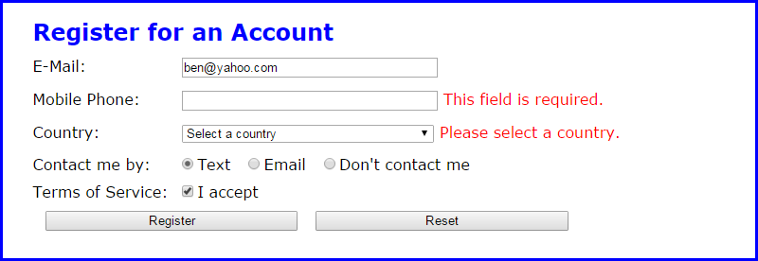
The Register application in a browser

Slide 46
The HTML of the Register application

Slide 47
The HTML (continued)

Slide 48
The CSS for the span elements in the registration form

Slide 49
The JavaScript for the Register application

Slide 50
The JavaScript (continued)

Slide 51
The JavaScript (continued)

Slide 52
One property of the Element interface for setting or returning HTML content

Slide 53
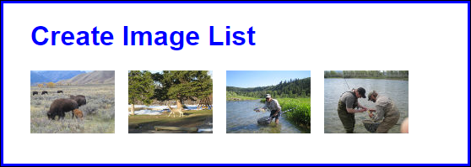
An application that displays a list of images

Slide 54
The starting HTML for the application

Slide 55
The JavaScript that adds the images to the list

Slide 56
How to get the HTML content of an element

Slide 57
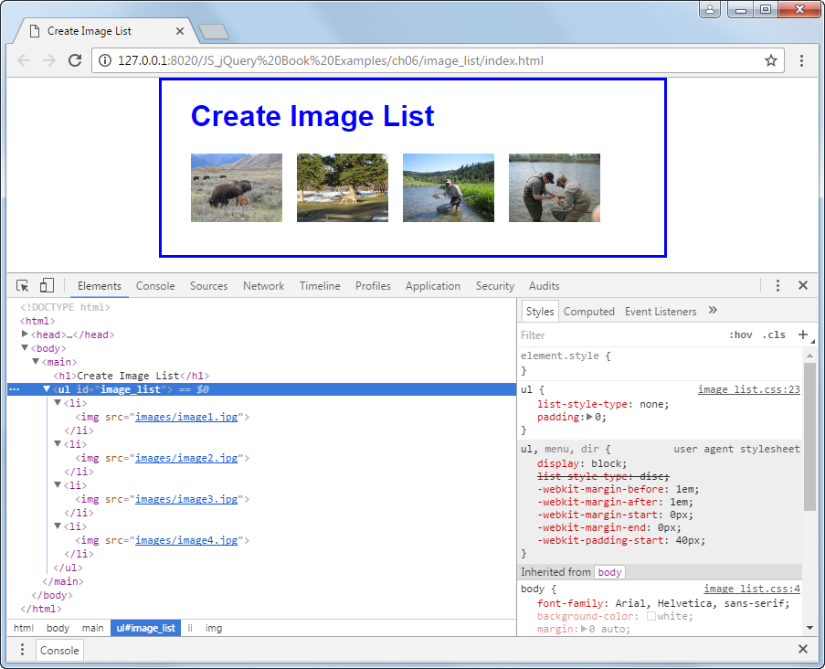
The Elements panel after JavaScript has changed the DOM

Slide 58
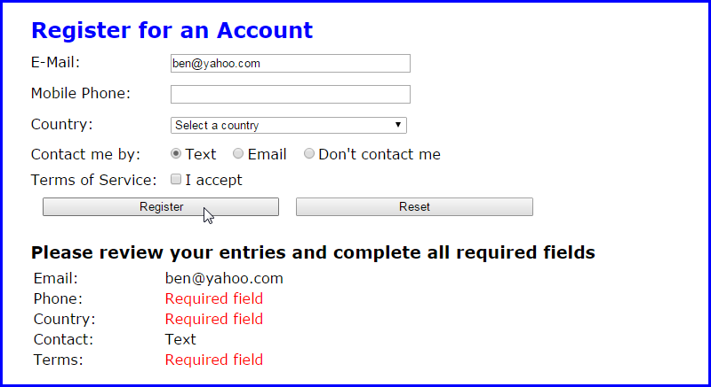
The Register application with a table that’s created for the user’s entries

Slide 59
The HTML for the elements below the form

Slide 60
The CSS for the span elements in the table

Slide 61
The JavaScript for the Register application

Slide 62
The JavaScript (continued)

Slide 63
The JavaScript (continued)

Slide 64
The JavaScript (continued)

Slide 65
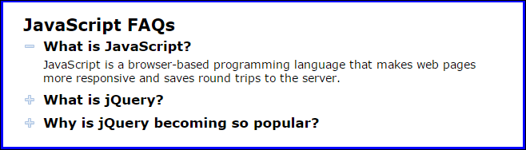
Exercise 6-1 Experiment with the FAQs app

Slide 66
Exercise 6-2 Add controls to the Register app

Slide 67
Exercise 6-3 Enhance the Email List application

Slide 68
Extra 6-1 Develop the Temp Converter app

Slide 69
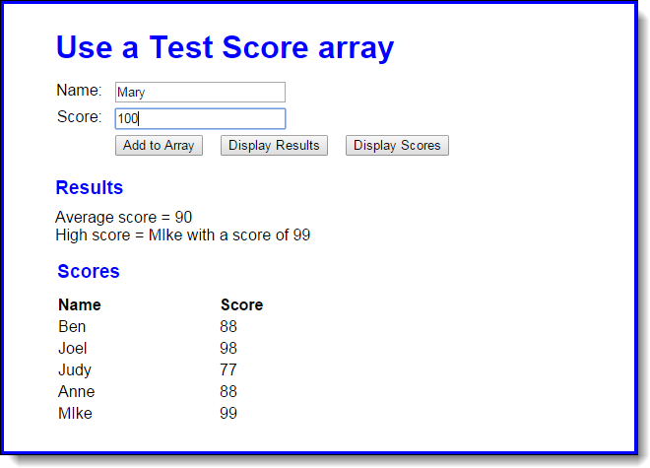
Extra 6-2 Use a Test Score array

Slide 70
Extra 6-3 Modify the FAQs application

Slide 71
Short 6-1 Upgrade the MPG application

Slide 72
Short 6-2 Display Text Score arrays

